Slide 1
File System Implementation

Slide 2
File System Implementation
File-System Structure
File-System Implementation
Directory Implementation
Allocation Methods
Free-Space Management

Slide 3
File-System Structure
File structure
  Logical storage unit
  Collection of related information
File system resides on secondary storage (disks)
File system organized into layers
File control block – storage structure consisting of information about a file

Slide 4
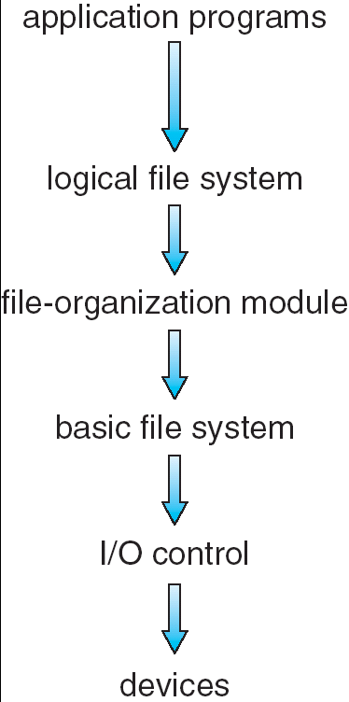
Layered File System

Slide 5
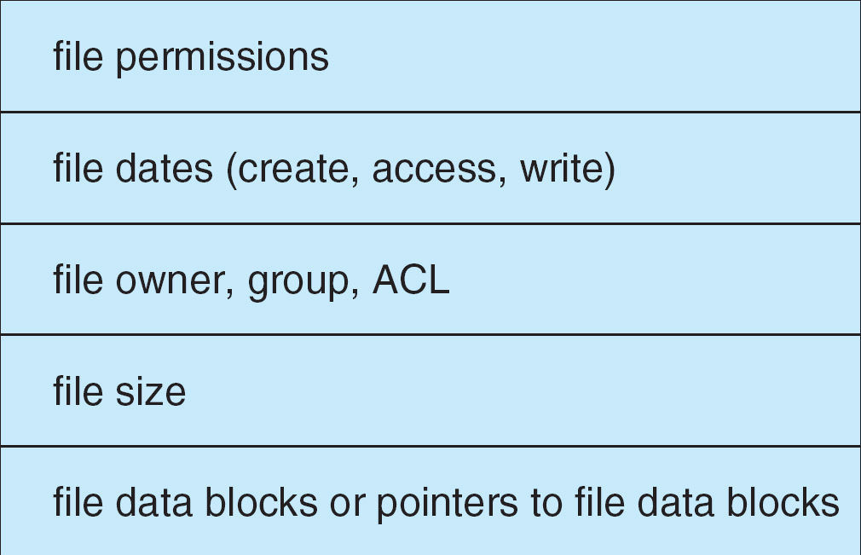
A Typical File Control Block

Slide 6
In-Memory File System Structures
The following figure illustrates the necessary file system structures provided by the operating systems.
Figure 12-3(a) refers to opening a file.
Figure 12-3(b) refers to reading a file.

Slide 7

In-Memory File System Structures

Slide 8
Directory Implementation
Linear list of file names with pointer to the data blocks.
  simple to program
  time-consuming to execute
Hash Table – linear list with hash data structure.
  decreases directory search time
  collisions – situations where two file names hash to the same location
  fixed size

Slide 9
Allocation Methods
An allocation method refers to how disk blocks are allocated for files:
Contiguous allocation
Linked allocation
Indexed allocation

Slide 10
Contiguous Allocation
Each file occupies a set of contiguous blocks on the disk
Simple – only starting location (block #) and length (number of blocks) are required
Random access
Wasteful of space (dynamic storage-allocation problem)
Files cannot grow

Slide 11

Contiguous Allocation of Disk Space

Slide 12
Linked Allocation
Each file is a linked list of disk blocks: blocks may be scattered anywhere on the disk.
block =
pointer

Slide 13
Linked Allocation (Cont.)
Simple – need only starting address
Free-space management system – no waste of space
No random access

Slide 14

Linked Allocation

Slide 15

File-Allocation Table

Slide 16
Indexed Allocation
Brings all pointers together into the index block.
Logical view.
index table

Slide 17

Example of Indexed Allocation

Slide 18
Indexed Allocation (Cont.)
Need index table
Random access
Dynamic access without external fragmentation, but have overhead of index block.

Slide 19
Indexed Allocation – Mapping (Cont.)

outer-index
index table
file

Slide 20
Free-Space Management
Bit vector (n blocks)
0
1
2
n-1
…
0 ⇒ block[i] free
1 ⇒ block[i] occupied
bit[i] =


Slide 21

Linked Free Space List on Disk

